Slide 1
DSGA 1017 Project -Audit of ADS
Data: Bank Marketing data
By:
Chitvan Goyal
Ilina Tripathi

Slide 2
Background
Objective: Technical audit of ADS developed for bank marketing campaign.
ADS: https://www.kaggle.com/code/janiobachmann/bank-marketing-campaign-opening-a-term-deposit
Dataset: Bank Marketing Dataset- details of direct marketing campaign of a Portuguese financial institution
Sensitive Features: age, marital status, education
Importance of fairness in marketing strategies: If the ADS is unfair in its predictions, it can lead to an unsuccessful marketing campaign. The bank will end up wasting resources and time on targets which won’t open a term deposit. On the other hand, when the ADS predicts No for potential customers who would open a term deposit, it can lead to poor customer service by the Bank.

Slide 3
Input and Output
10 - day_of_week: last contact day of the week (categorical)
11 - duration: last contact duration, in seconds (numeric)
12 - campaign: number of contacts performed during this campaign and for this client (numeric)
13 - pdays: number of days that passed by after the client was last contacted from a previous campaign (numeric)
14 - previous: number of contacts performed before this campaign and for this client (numeric)
15 - poutcome: outcome of the previous marketing campaign (categorical: 'failure','nonexistent','success')
Target: whether customer opened a Term deposit or not (categorical)
1 - age (numeric)
2 - job : type of job (categorical)
3 - marital : marital status (categorical)
4 - education (categorical)
5 - default: has credit in default? (categorical)
6 - housing: has housing loan? (categorical)
7 - loan: has personal loan? (categorical)
8 - contact: contact communication type (categorical)
9 - month: last contact month of year (categorical)

Slide 4
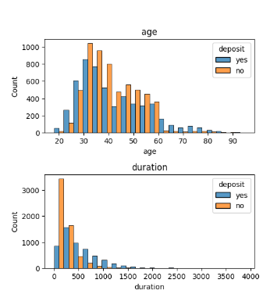
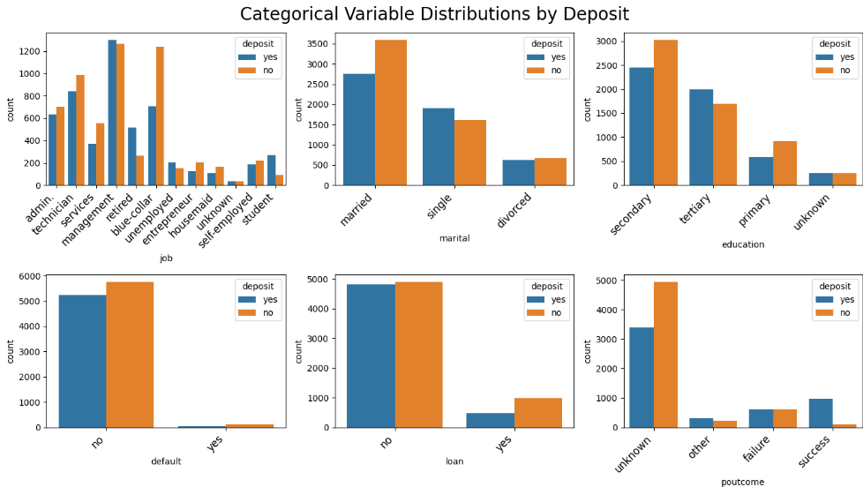
Input and Output

Slide 5
Implementation and validation
Data cleaning and preprocessing-
No missing values in the dataset
Most information lies in categorical variables which was encoded
Exploratory Data Analysis done to check distribution of features and correlations between them
Model training-
Stratified sampling used to prevent overfitting and allow a more representative train and test set
Multiple classifiers trained in ADS and performance analysed. Based on that, the top performing model (Gradient Boost Classifier) was used to predict the outcome
Performance evaluation-
ROC curve used to analyse performance; Gradient Boost Classifier achieved ROC score=91.73%
Test accuracy obtained with this model= 84.639%

Slide 6
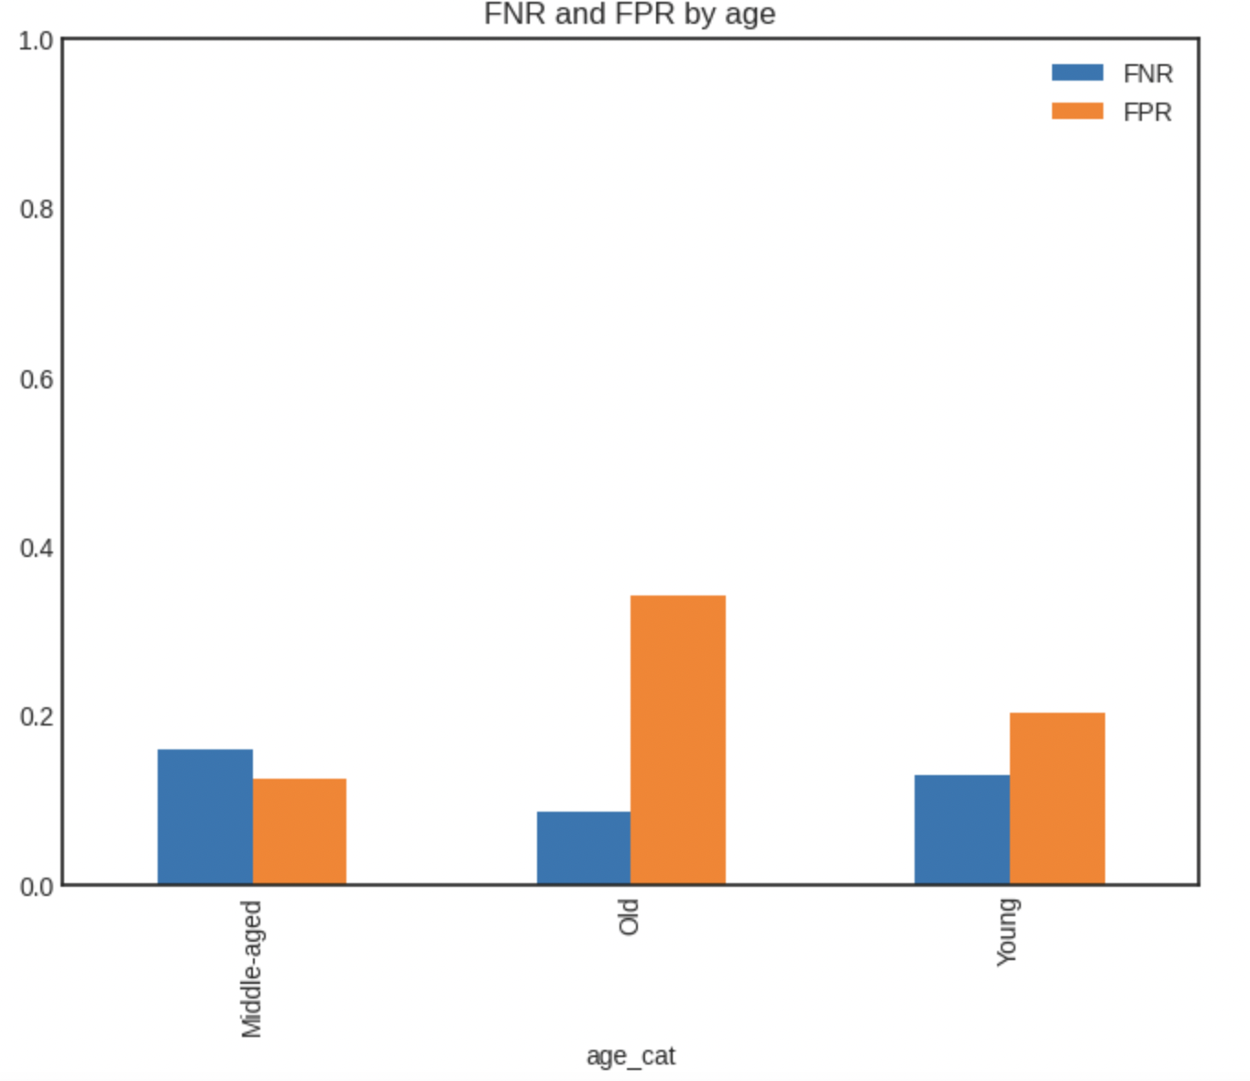
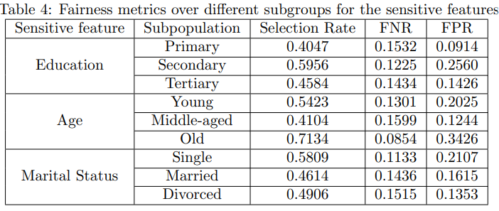
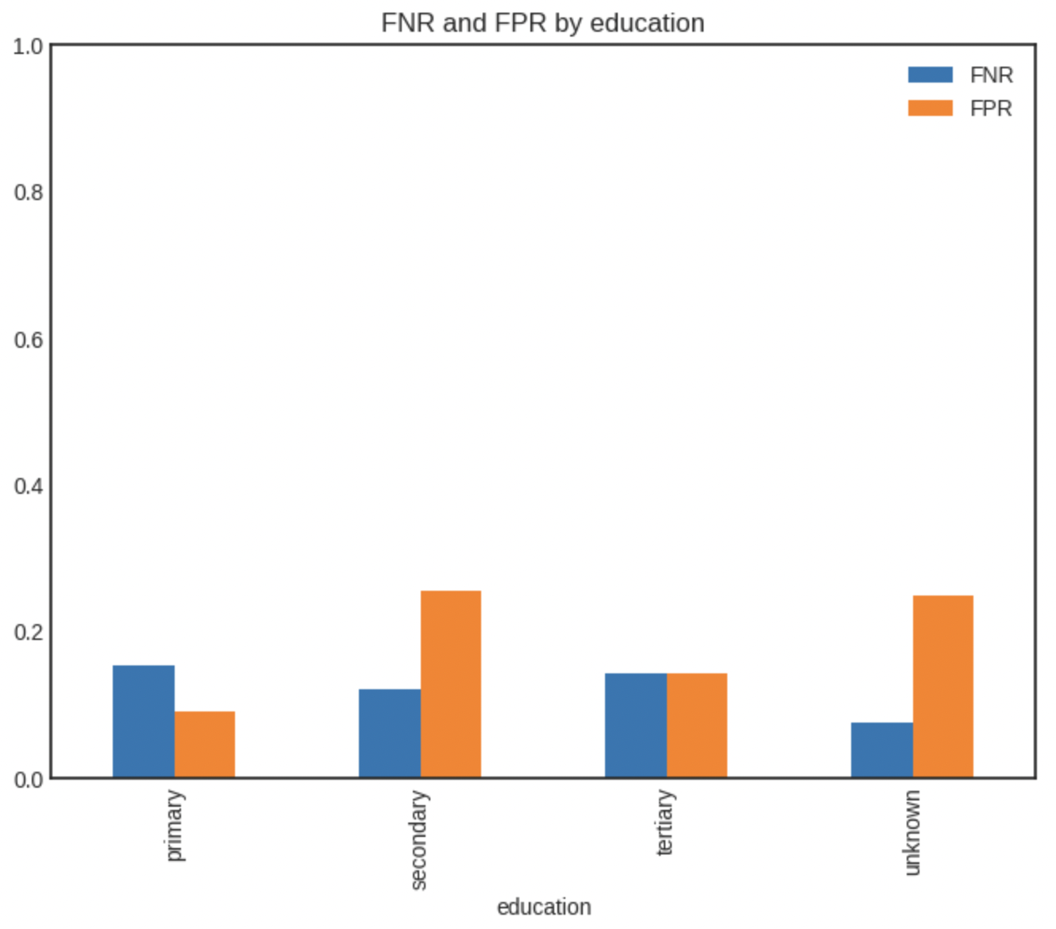
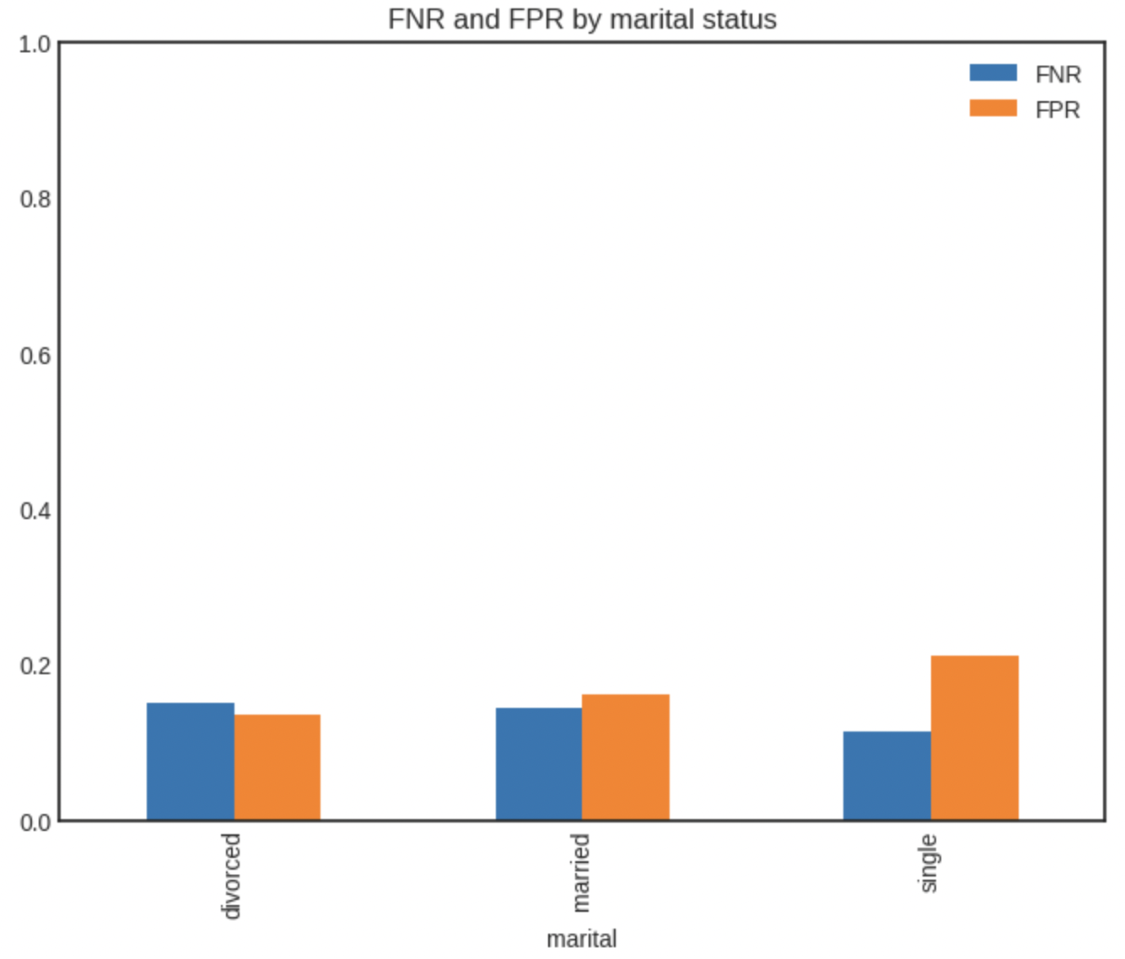
Outcomes

Slide 7
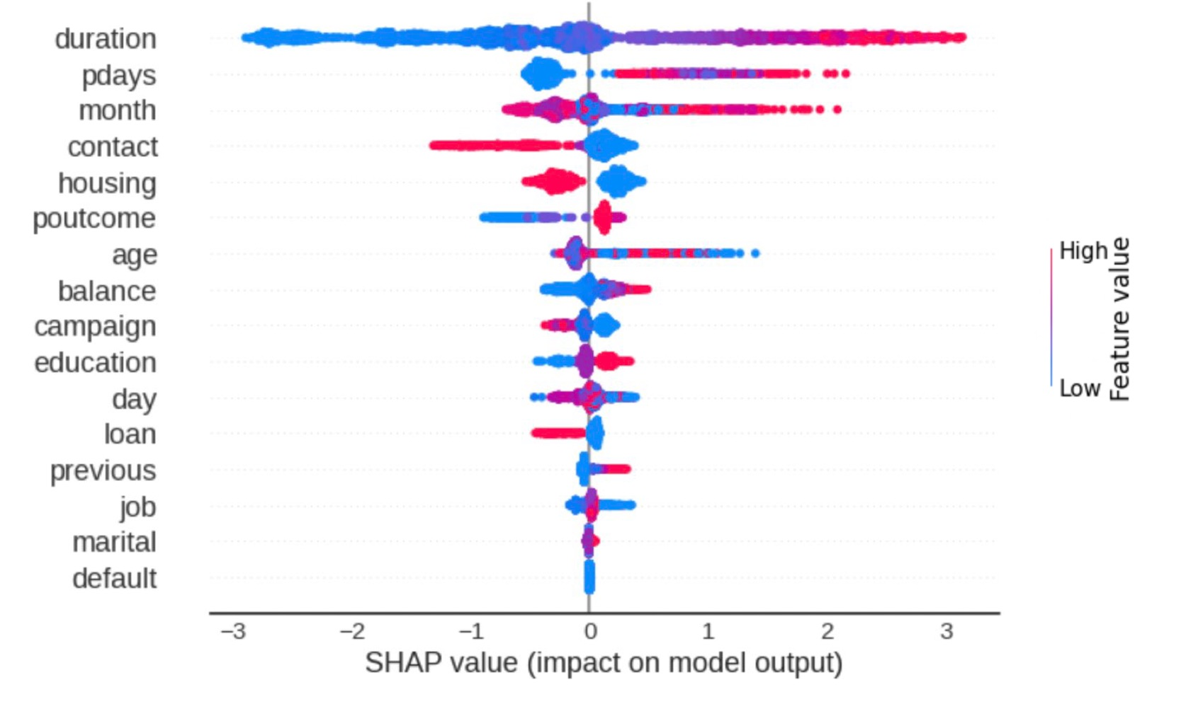
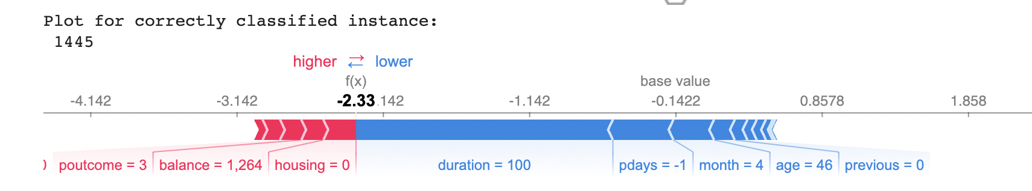
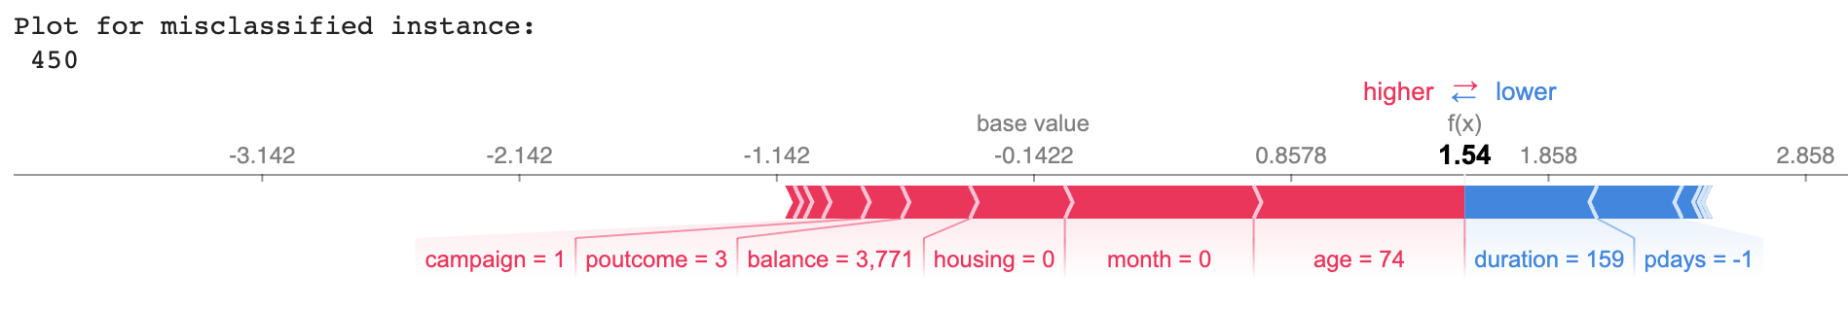
Outcomes
UCI repository has stated that is will bias the result because we will have duration data once the customer is contacted.
To test robustness duration was set to zero in test set, resulting in accuracy of 54.32%, significantly lower than model accuracy of 84.63%

Slide 8
Recommendations
Based on analysis-
ADS not robust enough to be deployed in the industry; uses ‘duration’ feature which is highly correlated with target variable but is not available before customer is contacted
Accuracy with ‘duration’ attribute set to 0: 54.32%
Fairness-
Accuracy, selection rate, FPR and FNR different across various subgroups in the sensitive attributes as discussed in outcomes.
The ADS appears to be biased towards old people, people with secondary education and single individuals.
This bias in prediction for the campaign can lead to an unsuccessful campaign, with the bank spending more resources on incorrect individuals
Many potential customers missed out on because ADS predicts ‘No’ for those

